Slide 1

HANDWRITTEN DIGIT RECOGNITION USING CNN AND RELU
Presented by-ANUSHREE Asthana
Intern id-MST03-0046
Guided by-urooj khan

Slide 2
Agenda:
Introduction to Handwritten Digit Recognition
MNIST Database Overview
Convolutional Neural Networks (CNNs)
Project Architecture
Implementation Steps
Results and Evaluation
Challenges and Future Work

Slide 3
Introduction to Handwritten Digit Recognition
Definition: Automatic interpretation of handwritten numeric digits
Applications:
Postal code reading
Bank check processing
Form digitization

Slide 4
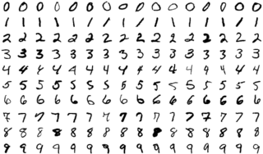
WHAT IS MNIST DATASET?
Modified National Institute of Standards and Technology database
60,000 training images, 10,000 testing images
28x28 pixel grayscale images of handwritten digits (0-9)
Widely used benchmark in machine learning

Slide 5
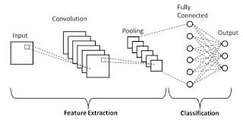
Convolutional Neural Networks (CNNs)
Deep learning architecture inspired by the visual cortex
Key components:
Convolutional layers
Pooling layers
Fully connected layers
Advantages for image processing tasks

Slide 6
Project Architecture
Input layer: 28x28 grayscale images
Convolutional layers: Feature extraction
Max pooling layers: Dimensionality reduction
Flatten layer: Prepare for fully connected layers
Dense layers: Classification
Output layer: 10 neurons (digits 0-9)

Slide 7
Implementation Steps
Data preprocessing: Normalization and reshaping
Model construction: Defining CNN architecture
Model compilation: Choosing optimizer and loss function
Training: Fitting the model to training data
Evaluation: Testing on separate test set

Slide 8
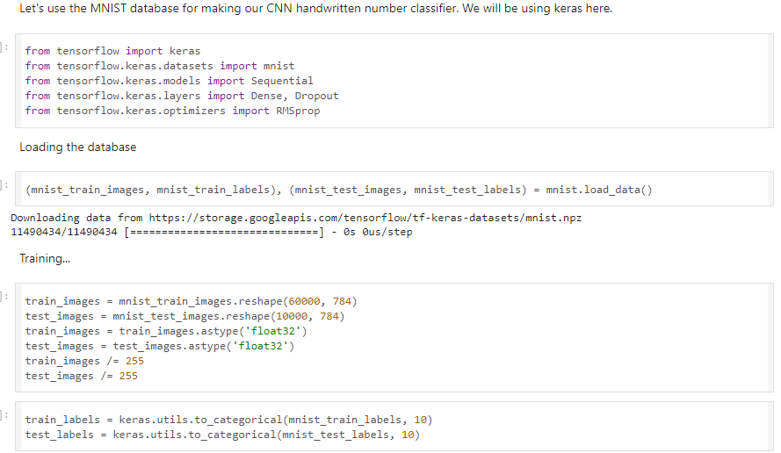
Code Snippet: Model Architecture

Slide 9
Training Process
Epochs: Number of times the model sees the entire dataset
Batch size: Number of samples processed before the model is updated
Validation split: Portion of training data used for validation

Slide 10
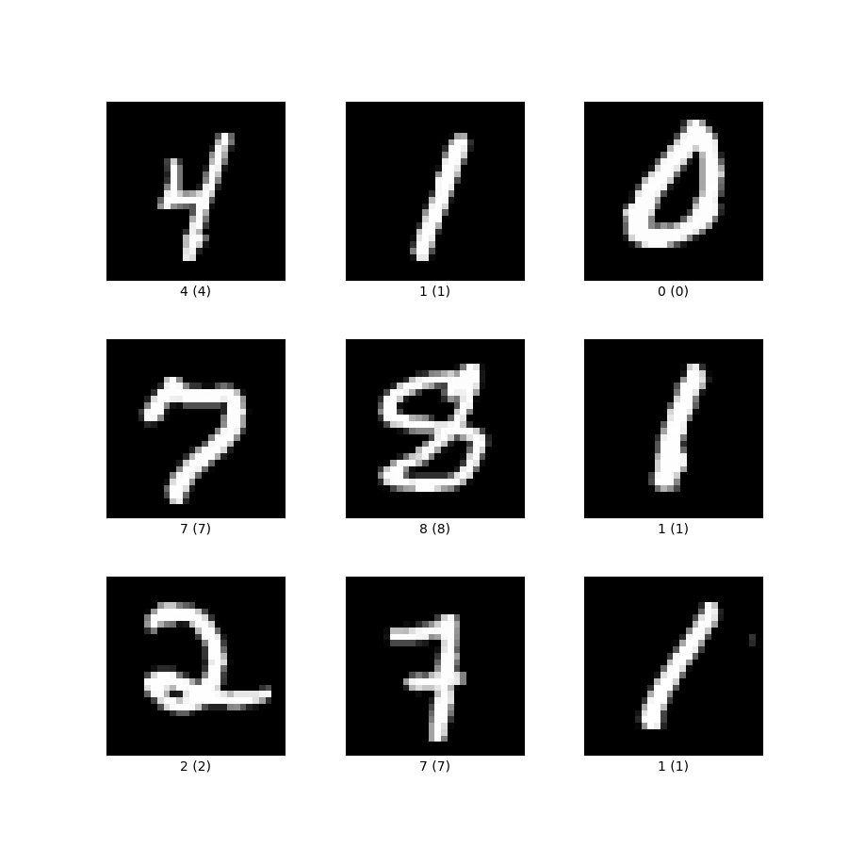
Results and Evaluation
Accuracy on test set: 0.982400000095367
Epochs: 10
Total loss: 0.06418716162443161

Slide 11
Epoch 1/10 : 600/600 - 6s - loss: 0.2453 - accuracy: 0.9285 - val_loss: 0.1283 - val_accuracy: 0.9634 - 6s/epoch - 11ms/step
Epoch 2/10 : 600/600 - 5s - loss: 0.0982 - accuracy: 0.9710 - val_loss: 0.0845 - val_accuracy: 0.9736 - 5s/epoch - 9ms/step
Epoch 3/10 : 600/600 - 6s - loss: 0.0655 - accuracy: 0.9798 - val_loss: 0.0736 - val_accuracy: 0.9764 - 6s/epoch - 10ms/step
Epoch 4/10 : 600/600 - 5s - loss: 0.0474 - accuracy: 0.9859 - val_loss: 0.0707 - val_accuracy: 0.9789 - 5s/epoch - 9ms/step
Epoch 5/10: 600/600 - 6s - loss: 0.0350 - accuracy: 0.9891 - val_loss: 0.0632 - val_accuracy: 0.9807 - 6s/epoch - 9ms/step
Epoch 6/10: 600/600 - 5s - loss: 0.0272 - accuracy: 0.9922 - val_loss: 0.0692 - val_accuracy: 0.9795 - 5s/epoch - 8ms/step
Epoch 7/10: 600/600 - 5s - loss: 0.0196 - accuracy: 0.9940 - val_loss: 0.0612 - val_accuracy: 0.9808 - 5s/epoch - 9ms/step
Epoch 8/10: 600/600 - 6s - loss: 0.0155 - accuracy: 0.9958 - val_loss: 0.0636 - val_accuracy: 0.9816 - 6s/epoch - 10ms/step
Epoch 9/10: 600/600 - 5s - loss: 0.0109 - accuracy: 0.9972 - val_loss: 0.0613 - val_accuracy: 0.9825 - 5s/epoch - 8ms/step
Epoch 10/10: 600/600 - 6s - loss: 0.0078 - accuracy: 0.9980 - val_loss: 0.0642 - val_accuracy: 0.9824 - 6s/epoch - 11ms/step

Slide 12
Challenges and Future Work
Challenges:
Variations in handwriting styles
Limited to digit recognition (0-9)
Future work:
Extend to alphanumeric characters
Real-time recognition from camera input
Transfer learning for other image classification tasks

Slide 13
THANK YOU
https://github.com/InannaxX07/ANUSHREE_SCIFOR/blob/main/Mini-project/CNN_Miniproject.ipynb

